Slide 1
Project 2
Comparison between fine-tuned, vanilla DistilBERT and ML models
Nayeem Mohammad

Slide 2
Experiments
Models | Epochs | Model names
DistilBERT fine-tuned | 3, 10, 20 | {‘model’: “distilbert-base-uncased”, ‘tokenizer’: “distilbert-base-uncased”}
GPT2 | 10, 20 | {‘model’: “gpt2”, ‘tokenizer’: “gpt2”}
DistilBERT vanilla | N/A | {‘model’: “distilbert-base-uncased”, ‘tokenizer’: “distilbert-base-uncased”}
Logistic Regression | N/A | sklearn.linear_mode.LogisticRegression CountVectorizer (Bag of Words)

Slide 3
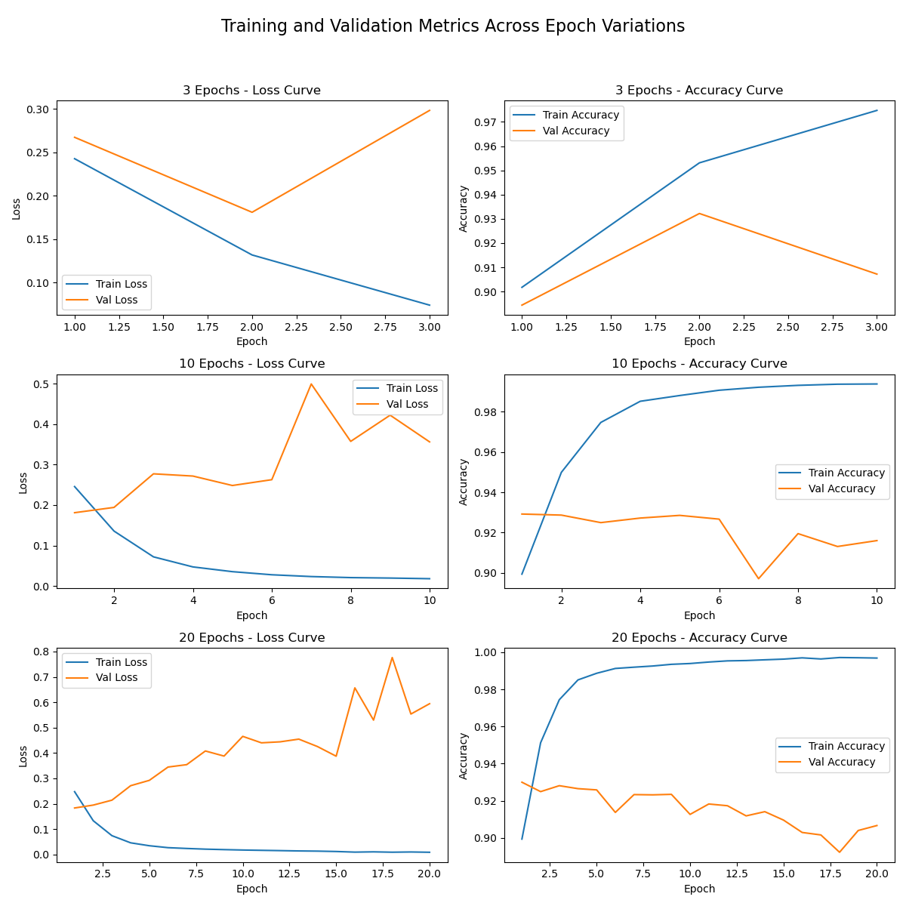
Fine-tuned DistilBERT Training & Validation accuracy and loss curves

Slide 4
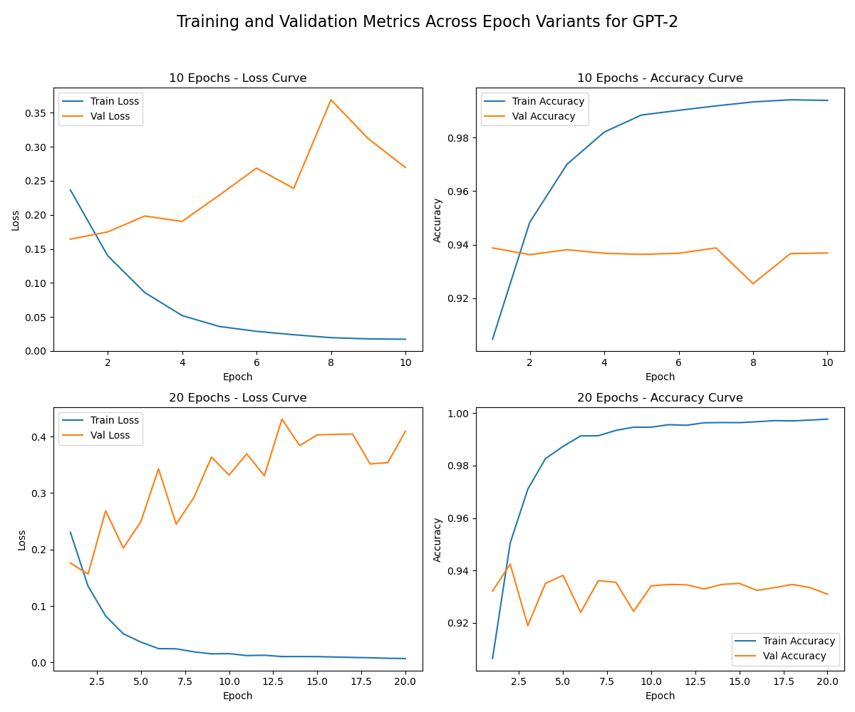
GPT2 Training & Validation accuracy and loss curves

Slide 5
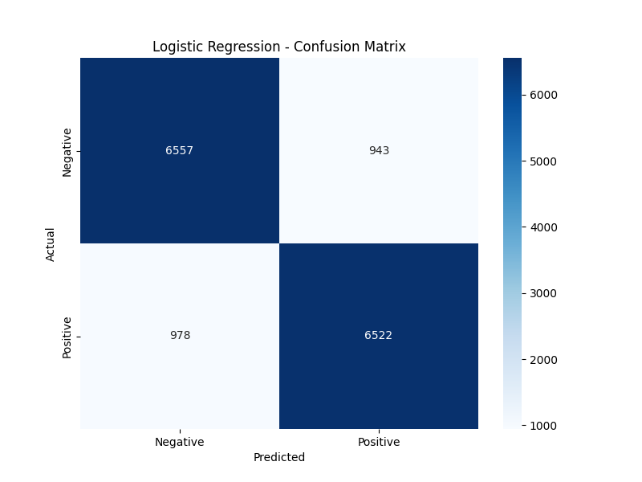
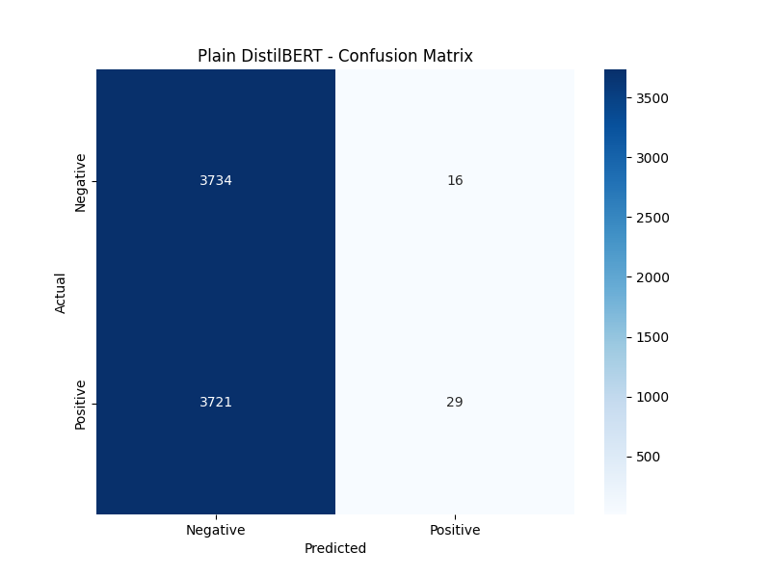
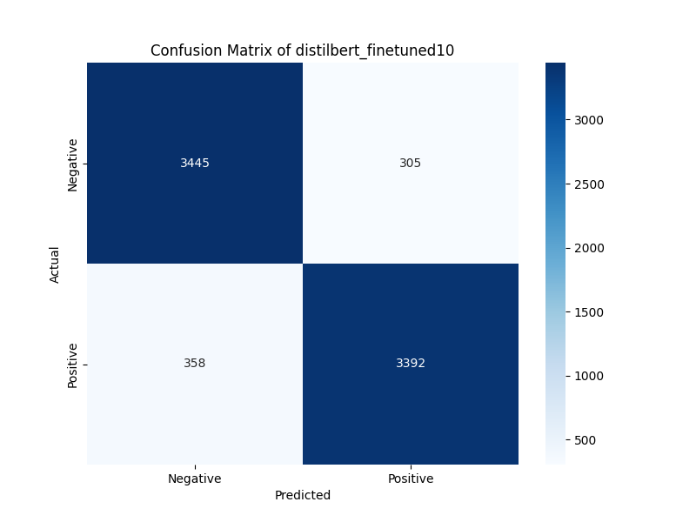
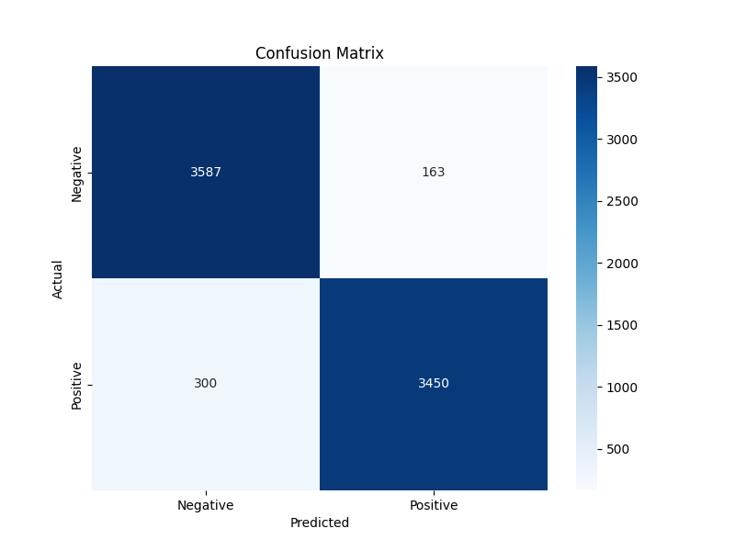
Confusion Matrix from all models

Slide 6
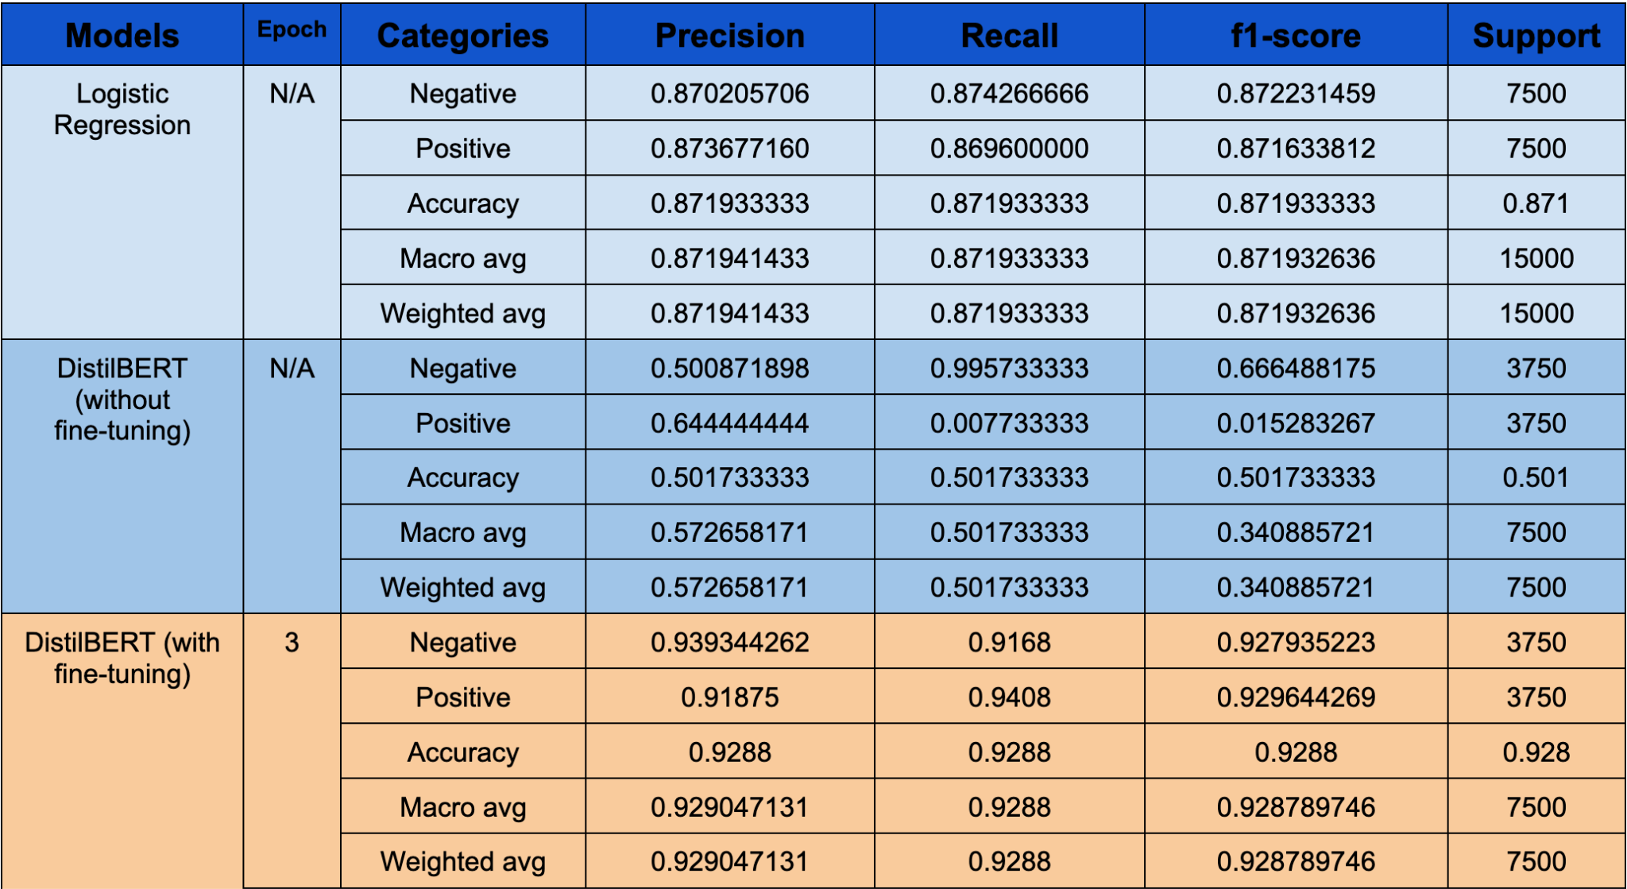
Metrics

Slide 7
Thank You

